Slide 1
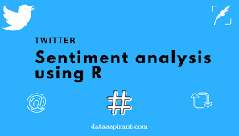
TWITTER SENTIMENT ANALYSIS
This Photo by Unknown Author is licensed under CC BY-SA
How Companies Can Understand Their Customers Through Social Media
Abe Freeman, Jeff Bertucci, Antonio Llorens

Slide 2

What Is Sentiment Analysis?
Method to Gauge Customer Emotion
Each Word is Weighted With a Sentiment Score
Score Added Up and Tweet is Categorized as GOOD/BAD/NUETRAL
Allows Companies Understand Their Customers
Track How Customers Respond to Promotions/Products/SRVCS
Allows Companies to Track Competitors
Measure Customer Response To Help Drive Strategy
Quantifiable Impact
Companies Can Trend Sentiment Score With Revenue

Slide 3

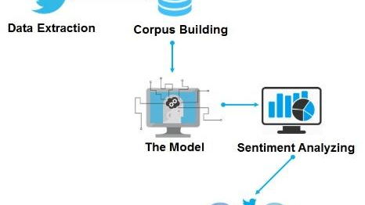

IMPLEMENTING SENTIMENT ANALYSIS
Extracting tweets using Twitter application
Cleaning the tweets for further analysis
Getting sentiment score for each tweet
Segregating positive and negative tweets

Slide 4
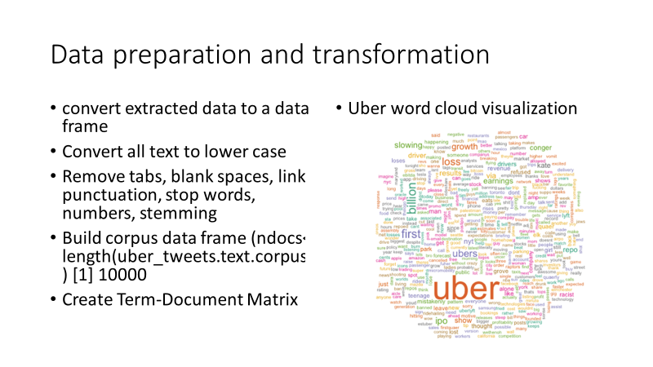
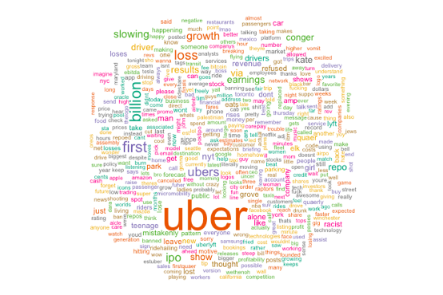
DATA PREPARATION AND TRANSFORMATION
convert extracted data to a data frame
Convert all text to lower case
Remove tabs, blank spaces, links, punctuation, stop words, numbers, stemming
Build corpus data frame (ndocs<-length(uber_tweets.text.corpus)) [1] 10000
Create Term-Document Matrix
Uber word cloud visualization

Slide 5
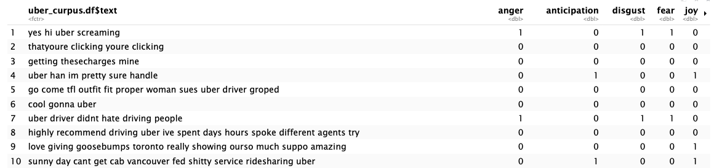
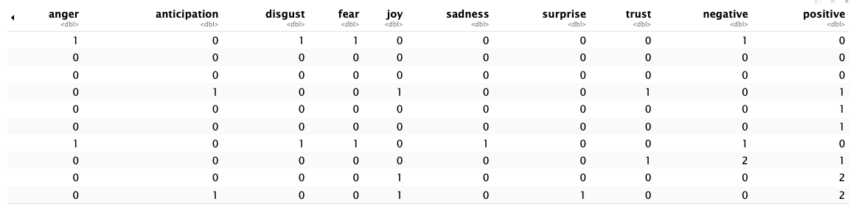
#getting sentiment score for each tweets. #breaks the emotion into 10 different emotions – anger, anticipation, disgust, fear, joy, sadness, surprise, trust, negative and positive

Slide 6
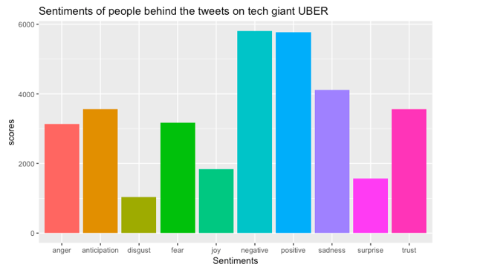
General emotions and their corresponding valence in uber corpus. (NRC sentiment dictionary)
Notes:
its observable that uber has a positive and negative impact on the consumers

Slide 7
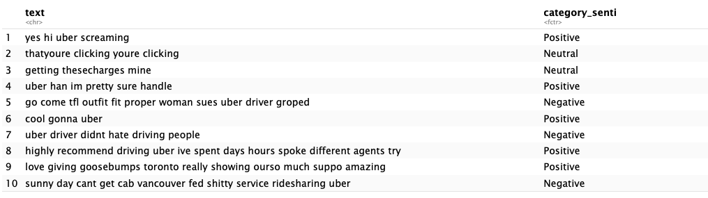

#classify as Positive, Negative or Neutral tweets category_senti <- ifelse(sent.value < 0, "Negative", ifelse(sent.value > 0, "Positive", "Neutral")) category_senti2 <- cbind(uber_curpus.df,category_senti) head(category_senti2, 10)
#break of total number of tweets by sentiment
table(category_senti)

Slide 8

Most Positive & Most Negative Tweet
[1] "imagine delight generous love empathetic understanding ubertalented playwrite poet clare"
[1] "dip$h!@ said wrong uber profitable go #$%! dumb@$$"

Slide 9
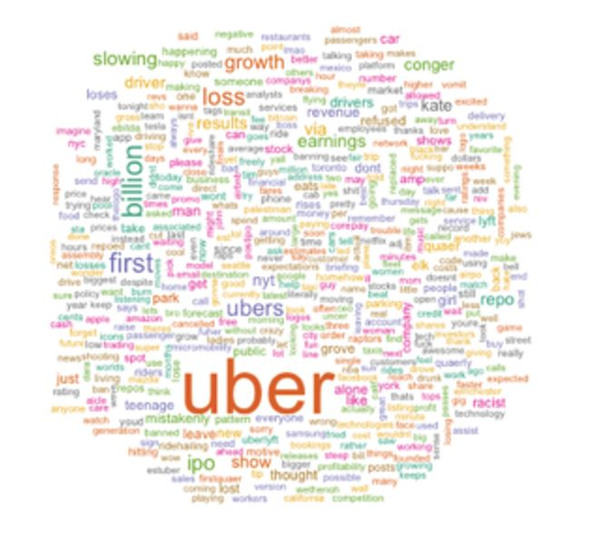

Slide 10
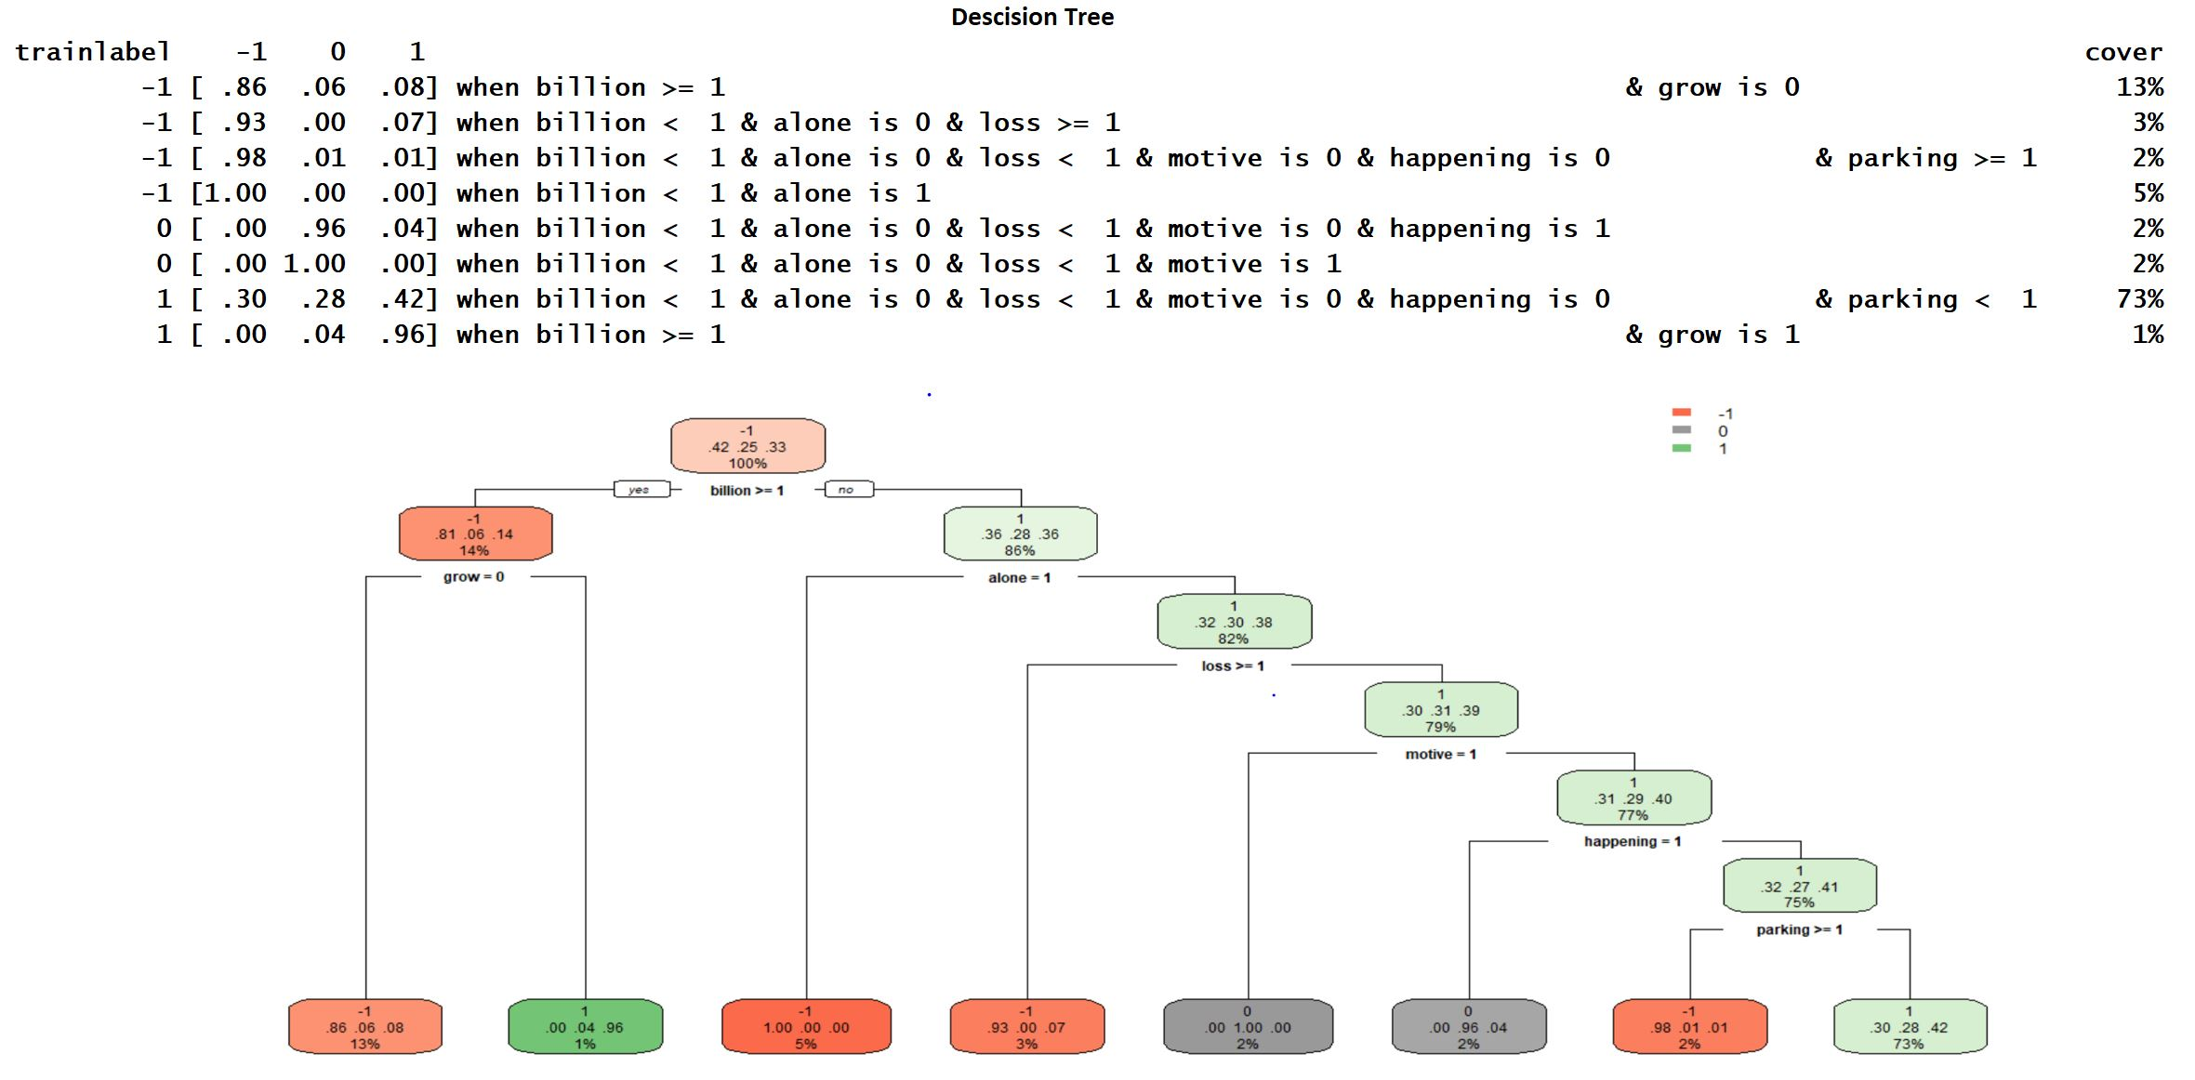

Slide 11
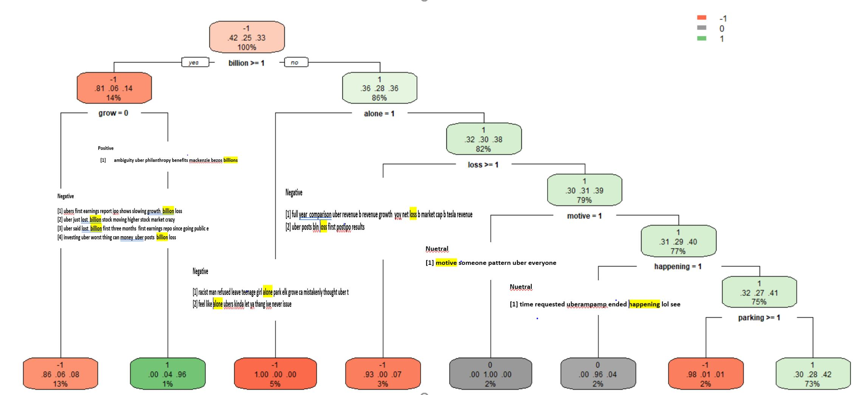

Slide 12
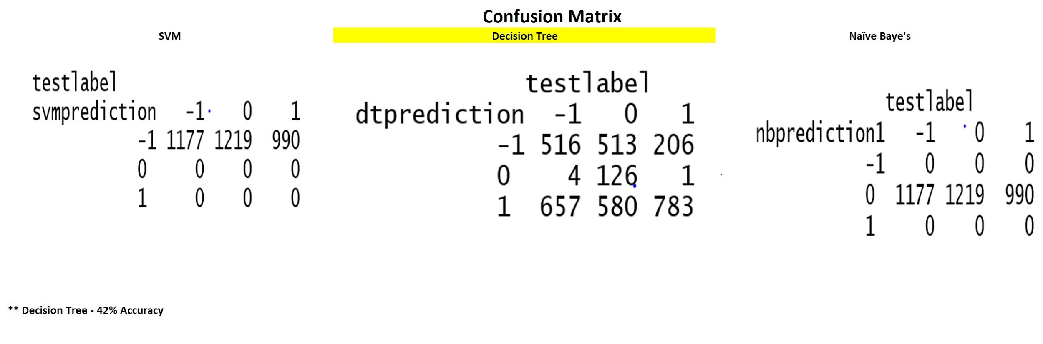

Slide 13
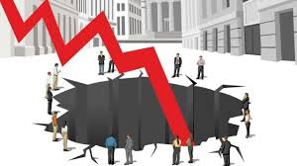
Conclusion
Uber’s Falling Stock Price Is Driving Sentiment
Spin the Narrative
Promote Positive Changes Within the Company
Promote Positive Changes Outside the Company
Perform Better

